Slide 1
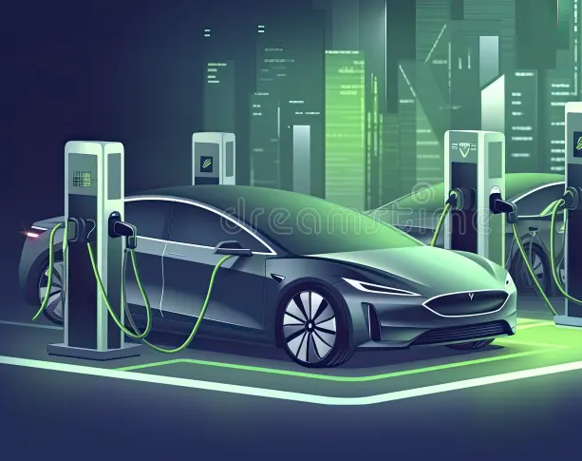
Title: The Electric Pulse: Analyzing the Current EV Landscape
Subtitle: A Data-Driven Deep Dive into 500 Electric Vehicles
Presenter:Ubaid Shaikh

Slide 2
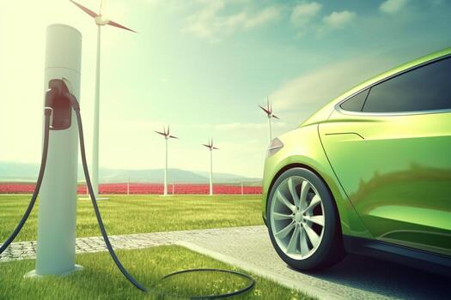
Exucutive summary
Overview: This analysis covers 500 EV records across major Indian cities (Delhi, Mumbai, Pune, Bangalore, etc.).
Key Findings: Tata and Tesla lead in volume, while battery capacity shows a direct (but non-linear) correlation with price.
Objective: To identify market gaps and consumer preferences in the evolving EV ecosystem.

Slide 3
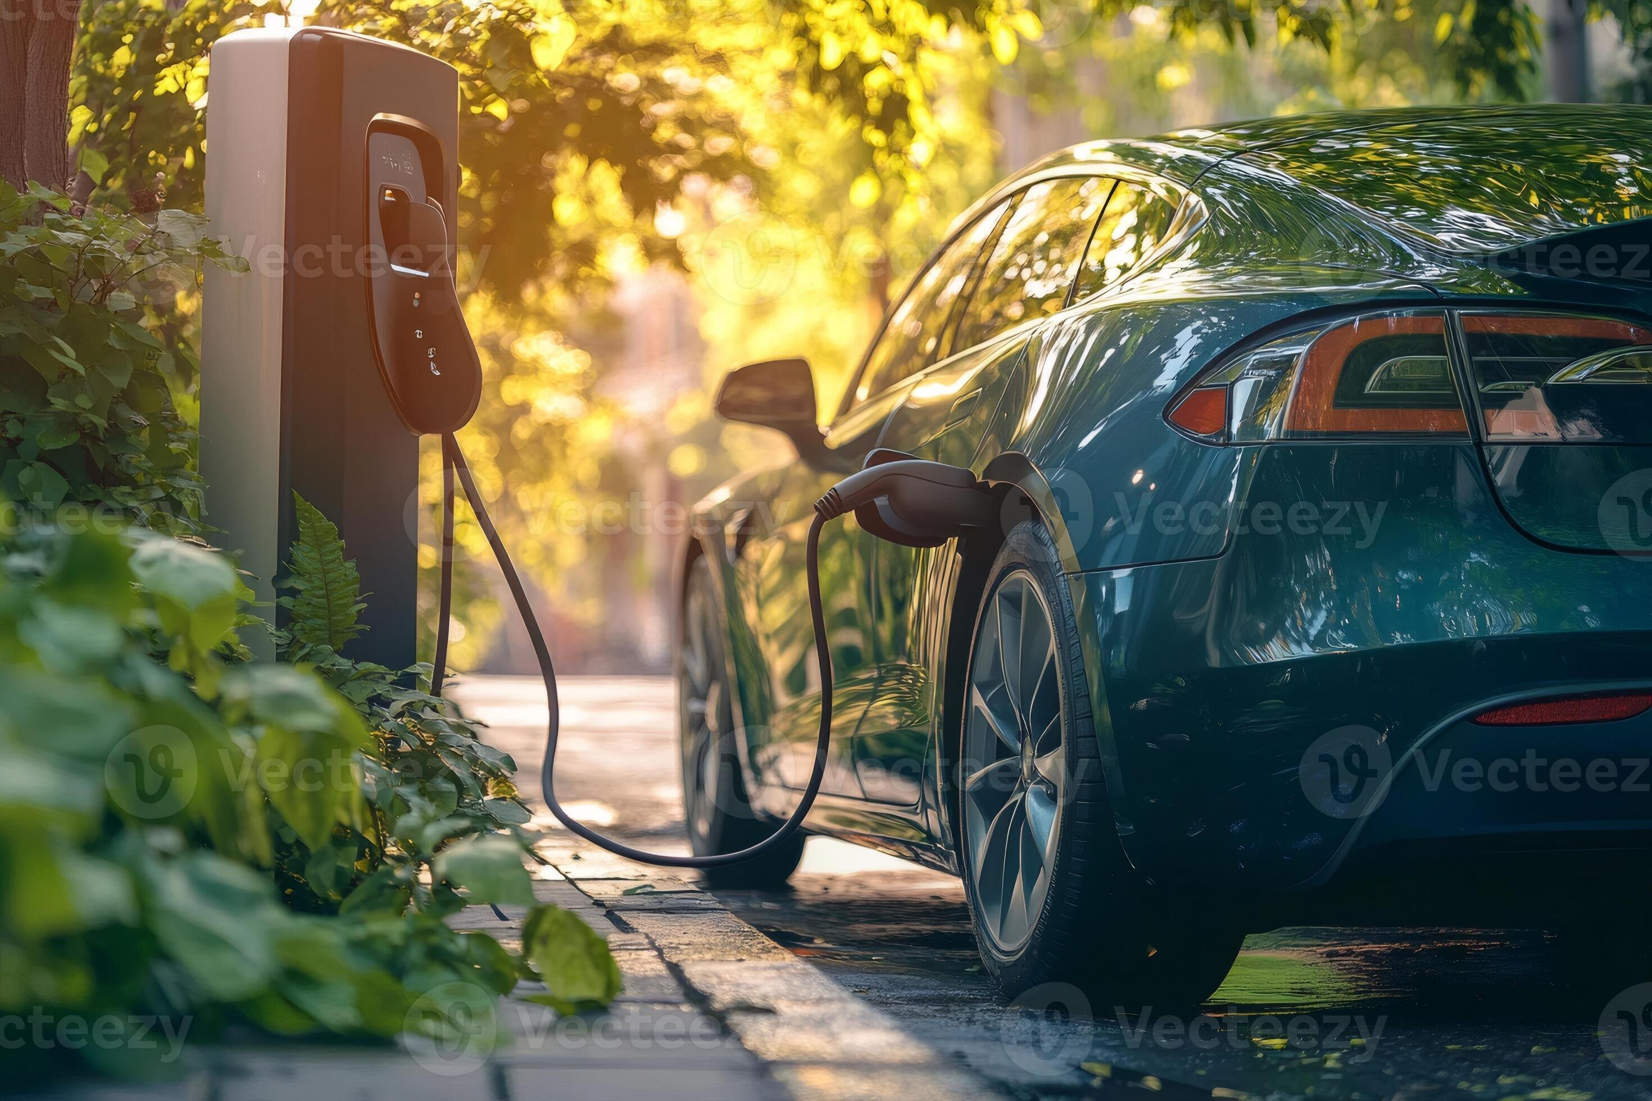

Market Composition by Brand
Dominant Players: Tata, Nissan, and Hyundai appear frequently, suggesting a strong footprint in the mid-range segment.
Luxury vs. Utility: Tesla and BMW (i3) represent the premium tech-heavy segment, while Mahindra and BYD focus on utility and fleet-friendly options.
Insight: The market is currently balanced between affordable commuters and high-performance imports.

Slide 4
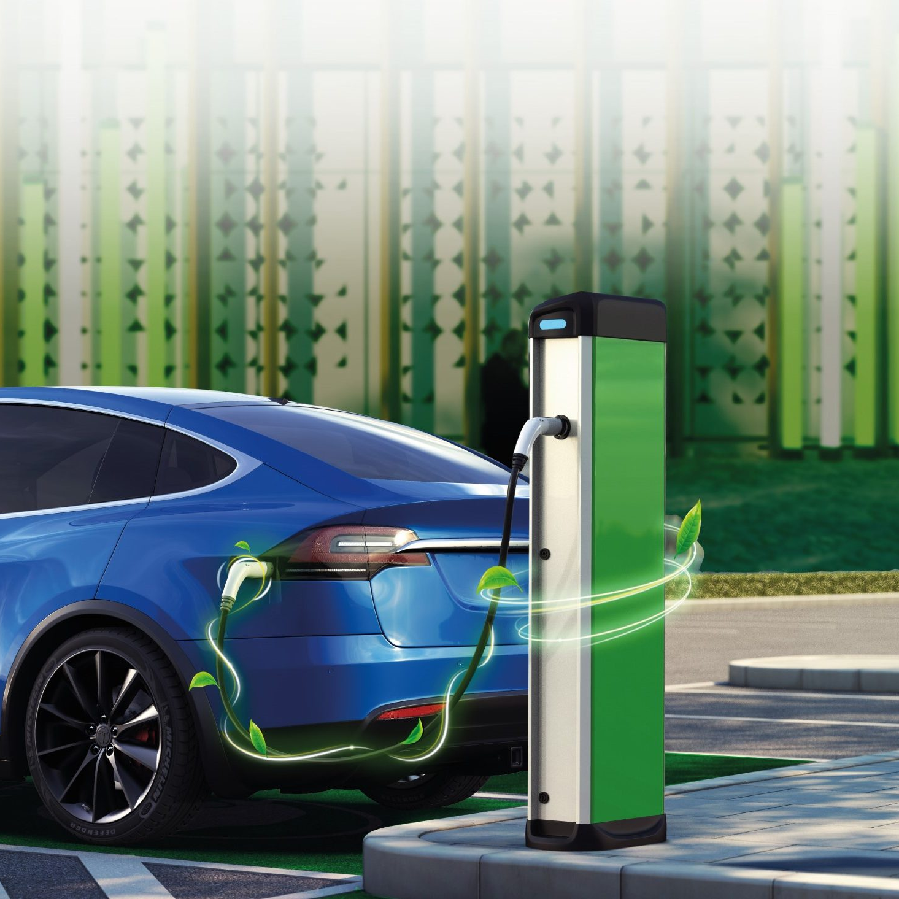
Battery Capacity vs. Driving Range
The Sweet Spot: Most vehicles cluster around the $40\text{--}60\text{ kWh}$ capacity range.
Efficiency Metric: We observe a trend where $1\text{ kWh}$ typically yields between $5\text{--}7\text{ km}$
of range, depending on the manufacturer’s drivetrain efficiency.
Outliers: Some models achieve "Extreme Range" (over $500\text{ km}$) but at a significant price premium.

Slide 5
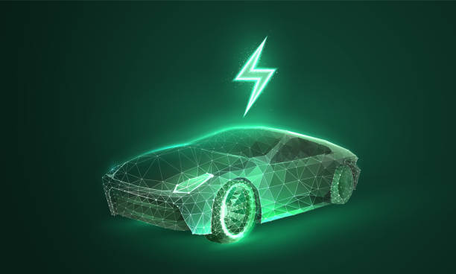
Pricing Analysis & Distribution
Price Spread: Vehicles range from ₹1,500,000 to over ₹6,000,000.
The "Mass Market" Bracket: A significant portion of the data points sit in the ₹25L to ₹40L range.
Inflation/Premium Factors: Prices aren't just determined by battery size; brand prestige and
"Rapid Charging" capabilities add a $15\text{--}20\%$ markup.

Slide 6
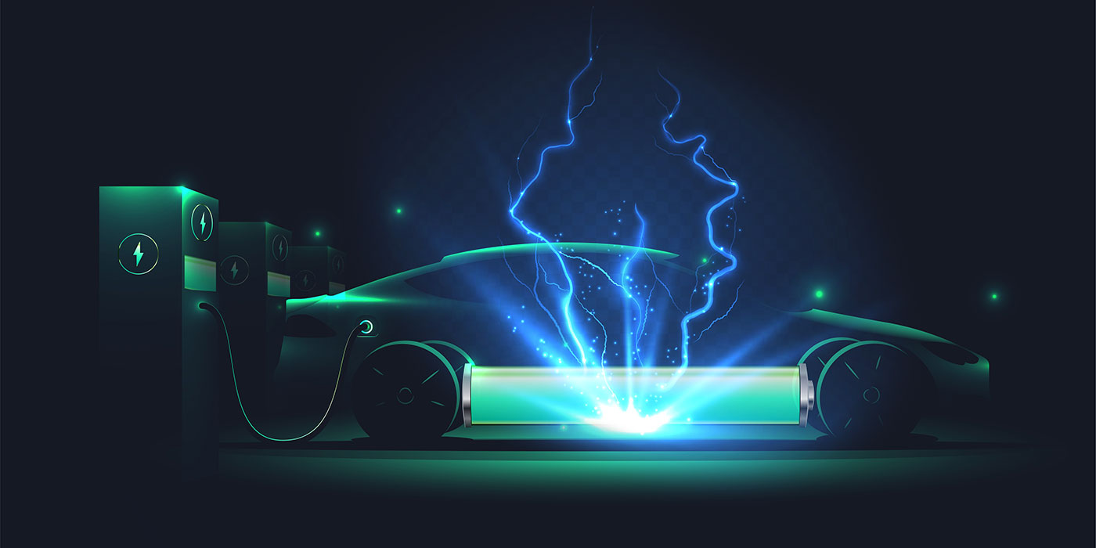
Charging Infrastructure Preferences
Charging Types: The data categorizes vehicles into Slow, Fast, and Rapid charging.
Trends:
Rapid: Preferred for high-range models (Model Y, Ioniq 5).
Slow/Fast: Common for urban commuters like the Tigor EV or Leaf.
Impact: Cities like Pune and Bangalore show a higher density of "Rapid" compatible vehicles.

Slide 7
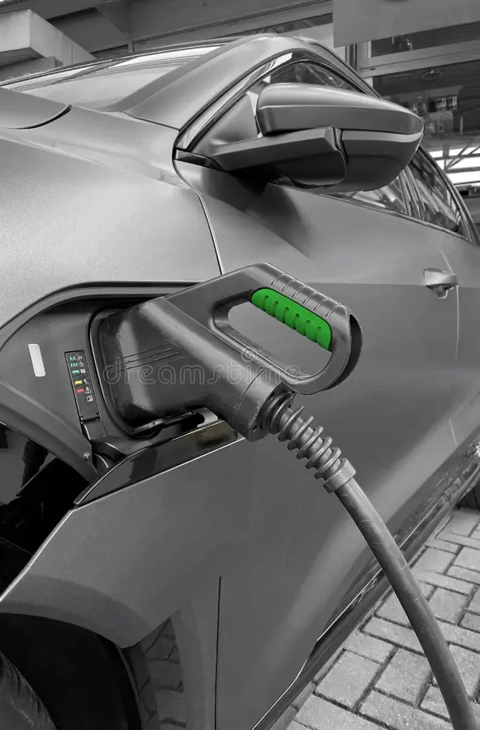
Regional Distribution (City Insights)
Top Hubs: Pune, Mumbai, and Delhi are the primary centers for EV registration in this
dataset.
City-Specific Preferences: * Delhi/Mumbai: Higher concentration of luxury models (Tesla/BMW).
Ahmedabad/Hyderabad: Growing adoption of mid-range Tata and Mahindra EVs.

Slide 8

The Evolution of Range (2018–2024)
Historical Context: Vehicles registered in 2018–2019 averaged lower ranges (approx $200\text{--}250\text{ km}$).
Modern Standards: Post-2022 registrations show a shift toward $400\text{+ km}$ as the standard consumer
expectation.
Tech Leap: Battery energy density has improved, allowing newer models to be lighter yet more powerful.

Slide 9
Correlations and Anomalies
The Price-Range Paradox: Occasionally, high-priced vehicles have lower ranges (focusing on luxury/speed), while some "Fast" charging mid-tier cars offer better ROI on range.
Battery Degradation Concerns: The data suggests a need to track older registrations (2018) to see how they perform against modern efficiency benchmarks.

Slide 10
Conclusion & Future Outlook
Summary: The data reflects a maturing market where range anxiety is being solved by better
battery tech.
Next Steps: * Standardization of "Rapid" charging across all tiers.
Price reduction through localizing battery manufacturing.
Final Quote: "The future of mobility isn't just electric; it's efficient."

